Slide 1
deformable model for estimating clothed and naked human shapes from a single image
Presentor : Jin-Hyuck Cha

Slide 2
Contents
Introduction
Overview
Learning phase
Fitting phase
Result

Slide 3
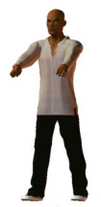
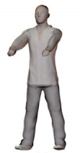
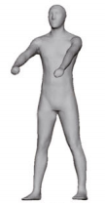
Introduction
simultaneously estimate a person’s clothed and naked shapes from a single image of that person wearing clothing
Propose a deformable model of clothed human shape to address the problem of estimating a person’s 3D shape from a single image of that person wearing clothing

Slide 4
OverView
Learning phase
Construct a training dataset to learn the deformable model of clothed human shape
2. Fitting phase
- Pose fitting step
- Shape fitting step
- Optimal (θ,β,γ)
- The naked 3D shape can be created with only the pose and body parameters (θ,β)

Slide 5
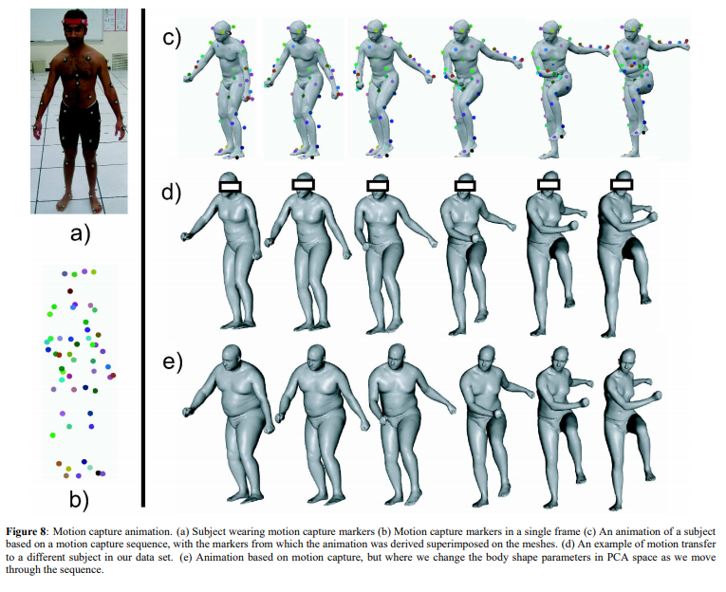
Dataset : the SCAPE(Shape Completion and Animation of People) model
SCAPE is a deformable human model learned from 3D scans, which are acquired using a Cyberware whole body scanner. Given two sets of lowdimensional parameters: pose parameter θ and body parameter β, the SCAPE method can produce realistic 3D surface mesh with the specified pose and body efficiently.

Slide 6
Learning phase
Training dataset contains body-shape, pose-shape, clothed-shape
The body-shape dataset approximately includes 111 aligned laser range scans of different people in a similar pose (56 men and 55 women)
The pose-shape dataset includes additional scans of one individual in roughly 70 poses
The clothed-shape dataset is built using the deformation transfer algorithm
θ determines the pose deformation
β determines the body shape
γ clothed type
(β ,γ) determine the clothing deformation

Slide 7
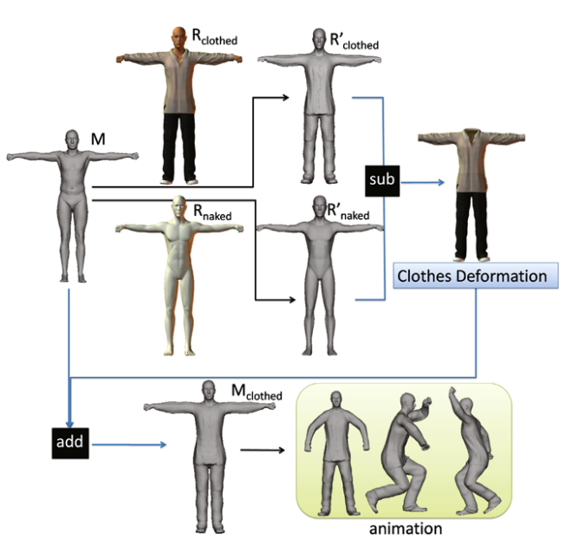
Learning phase
M(instance mesh) is a given naked shape in T pose
The work flow of deforming a naked shape to a clothed one. M is a given naked shape in T pose. Rnaked is a naked shape in POSER library and Rclothed is the same person with clothes on. We deform M to R clothed taking Rclothed as reference, also to Rnaked taking Rnaked as reference. The deformation from Rclothed to Rnaked is added to M and we get the result Mclothed, which has the same body as M. The resulted shape can be used for further deformation like animation
We deform M to Rclothed and Rnaked according to Rclothed and Rnaked, respectively, with 7 user-given mark points (4 for feet, 2 for hands, and 1 for nose)
a pair of high-quality human meshes {Pnaked, Pclothed} as reference from POSER(library)

Slide 8
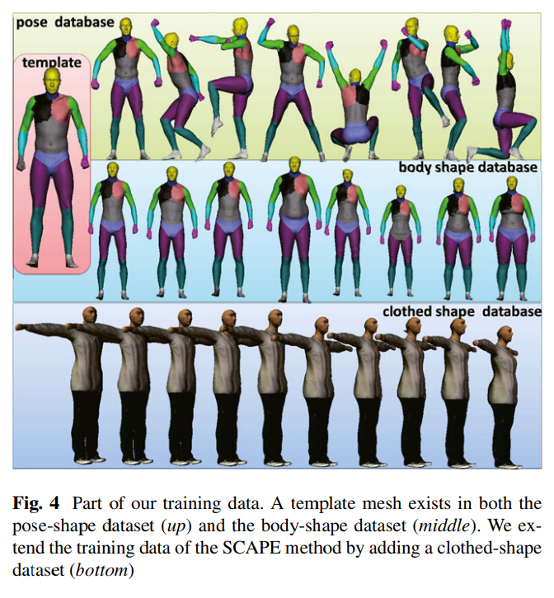
Learning phase
mesh contains 1.5k vertexes and 2.5k triangle faces with 18 body parts

Slide 9



Learning phase
Body part b
Relative rotation R
Template mesh T
Instance mesh M
Joint rotation estimation We manually estimated the pose of the template mesh and get the absolute rotation of every body part with forward kinematics, then we estimate the pose for other meshes automatically
Deformation processing Given an instance mesh M in the training dataset, the main idea is to deform the template mesh T to M and learn the deformation parameters.
be the vertexes of the kth triangle face of T
3 × 3 liner transformation matrix for the kth triangle
representing clothing-related deformation, body-shape-dependent deformation, and pose-dependent deformation separately
for the kth face in M

Slide 10
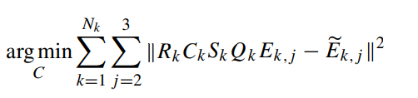

Learning phase
Learning the clothing-related deformation We learn a set of coefficients for each type of clothes in the dataset.
are the corresponding edges of the instance mesh M
The bodyshape deformation S is already obtained since M has a corresponding naked shape in the shape dataset. Meanwhile, the absolute rotation matrix of the template and the T -pose are also known values, which determine Q and R. Therefore, this problem can be solved by using a straightforward least-squares optimization

Slide 11
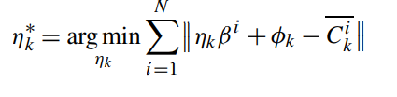
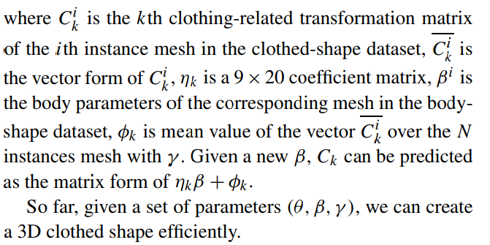
Learning phase

Slide 12

Fitting phase
Initial estimate
a 3D initial pose θ0 is recovered with the state-of-the-art IK algorithm, β0 is set to the mean body, and the clothes type is chosen by the user. We follow the foreground segmentation of [12], and perform pose fitting and body fitting iteratively to get the optimal parameters (θ,β)∗ automatically.
Finally, we generate a pair of estimated shapes {Mclothed,Mnaked} for further applications.

Slide 13
Fitting phase
Initialization
Users need to click a few points on the major joints and select the clothes type of the target person in the in image
the user refine the segmentation result if necessary
Initial human pose is estimated from a few 2D points corresponding to the major joints of the subject
Users’ inputs are generally noisy
Hence, extracts prior information embedded in millions of example poses and uses it to generate a desired pose from constraints specified by the user
We use the CMU motion capture dataset (2.8 million poses)2 as training data, and represent each pose q as a 23-dimensional vector

Slide 14


Fitting phase
Pose fitting
penalizes large change of limb rotation, wt = 1 in all our experiments

Slide 15
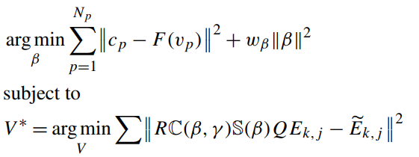

Fitting phase
Body fitting
functions learned in previous section

Slide 16
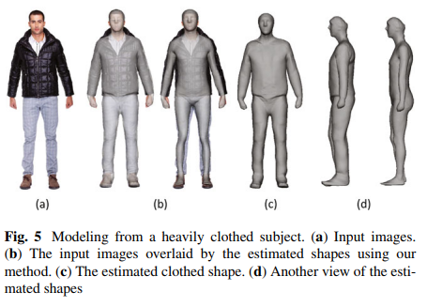
Result
People wearing thick clotehs can extract body types
But there aren’t GT, So We don’t know whether it’s real or not

Slide 17
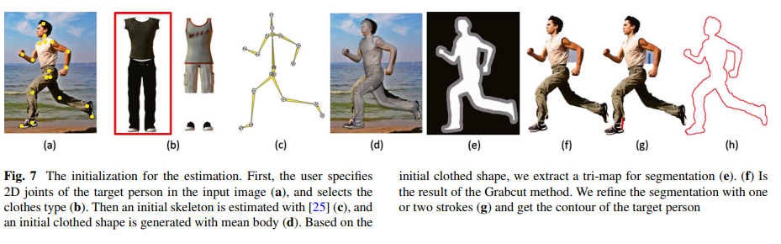
Result
Interesting : Choose the type of clothing which person wear

Slide 18
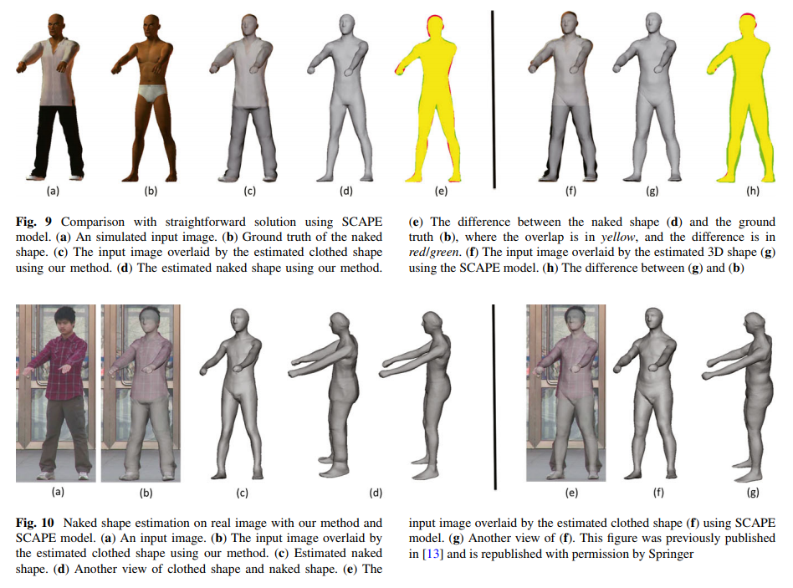
Result

Slide 19
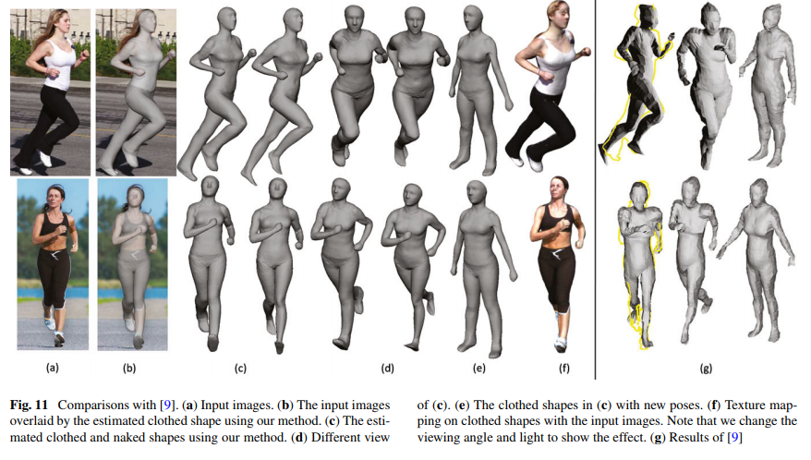
Result
Our experiments show that the method can estimate both the clothed and naked human shape of a dressed subject

Slide 20
End

